Slide 1
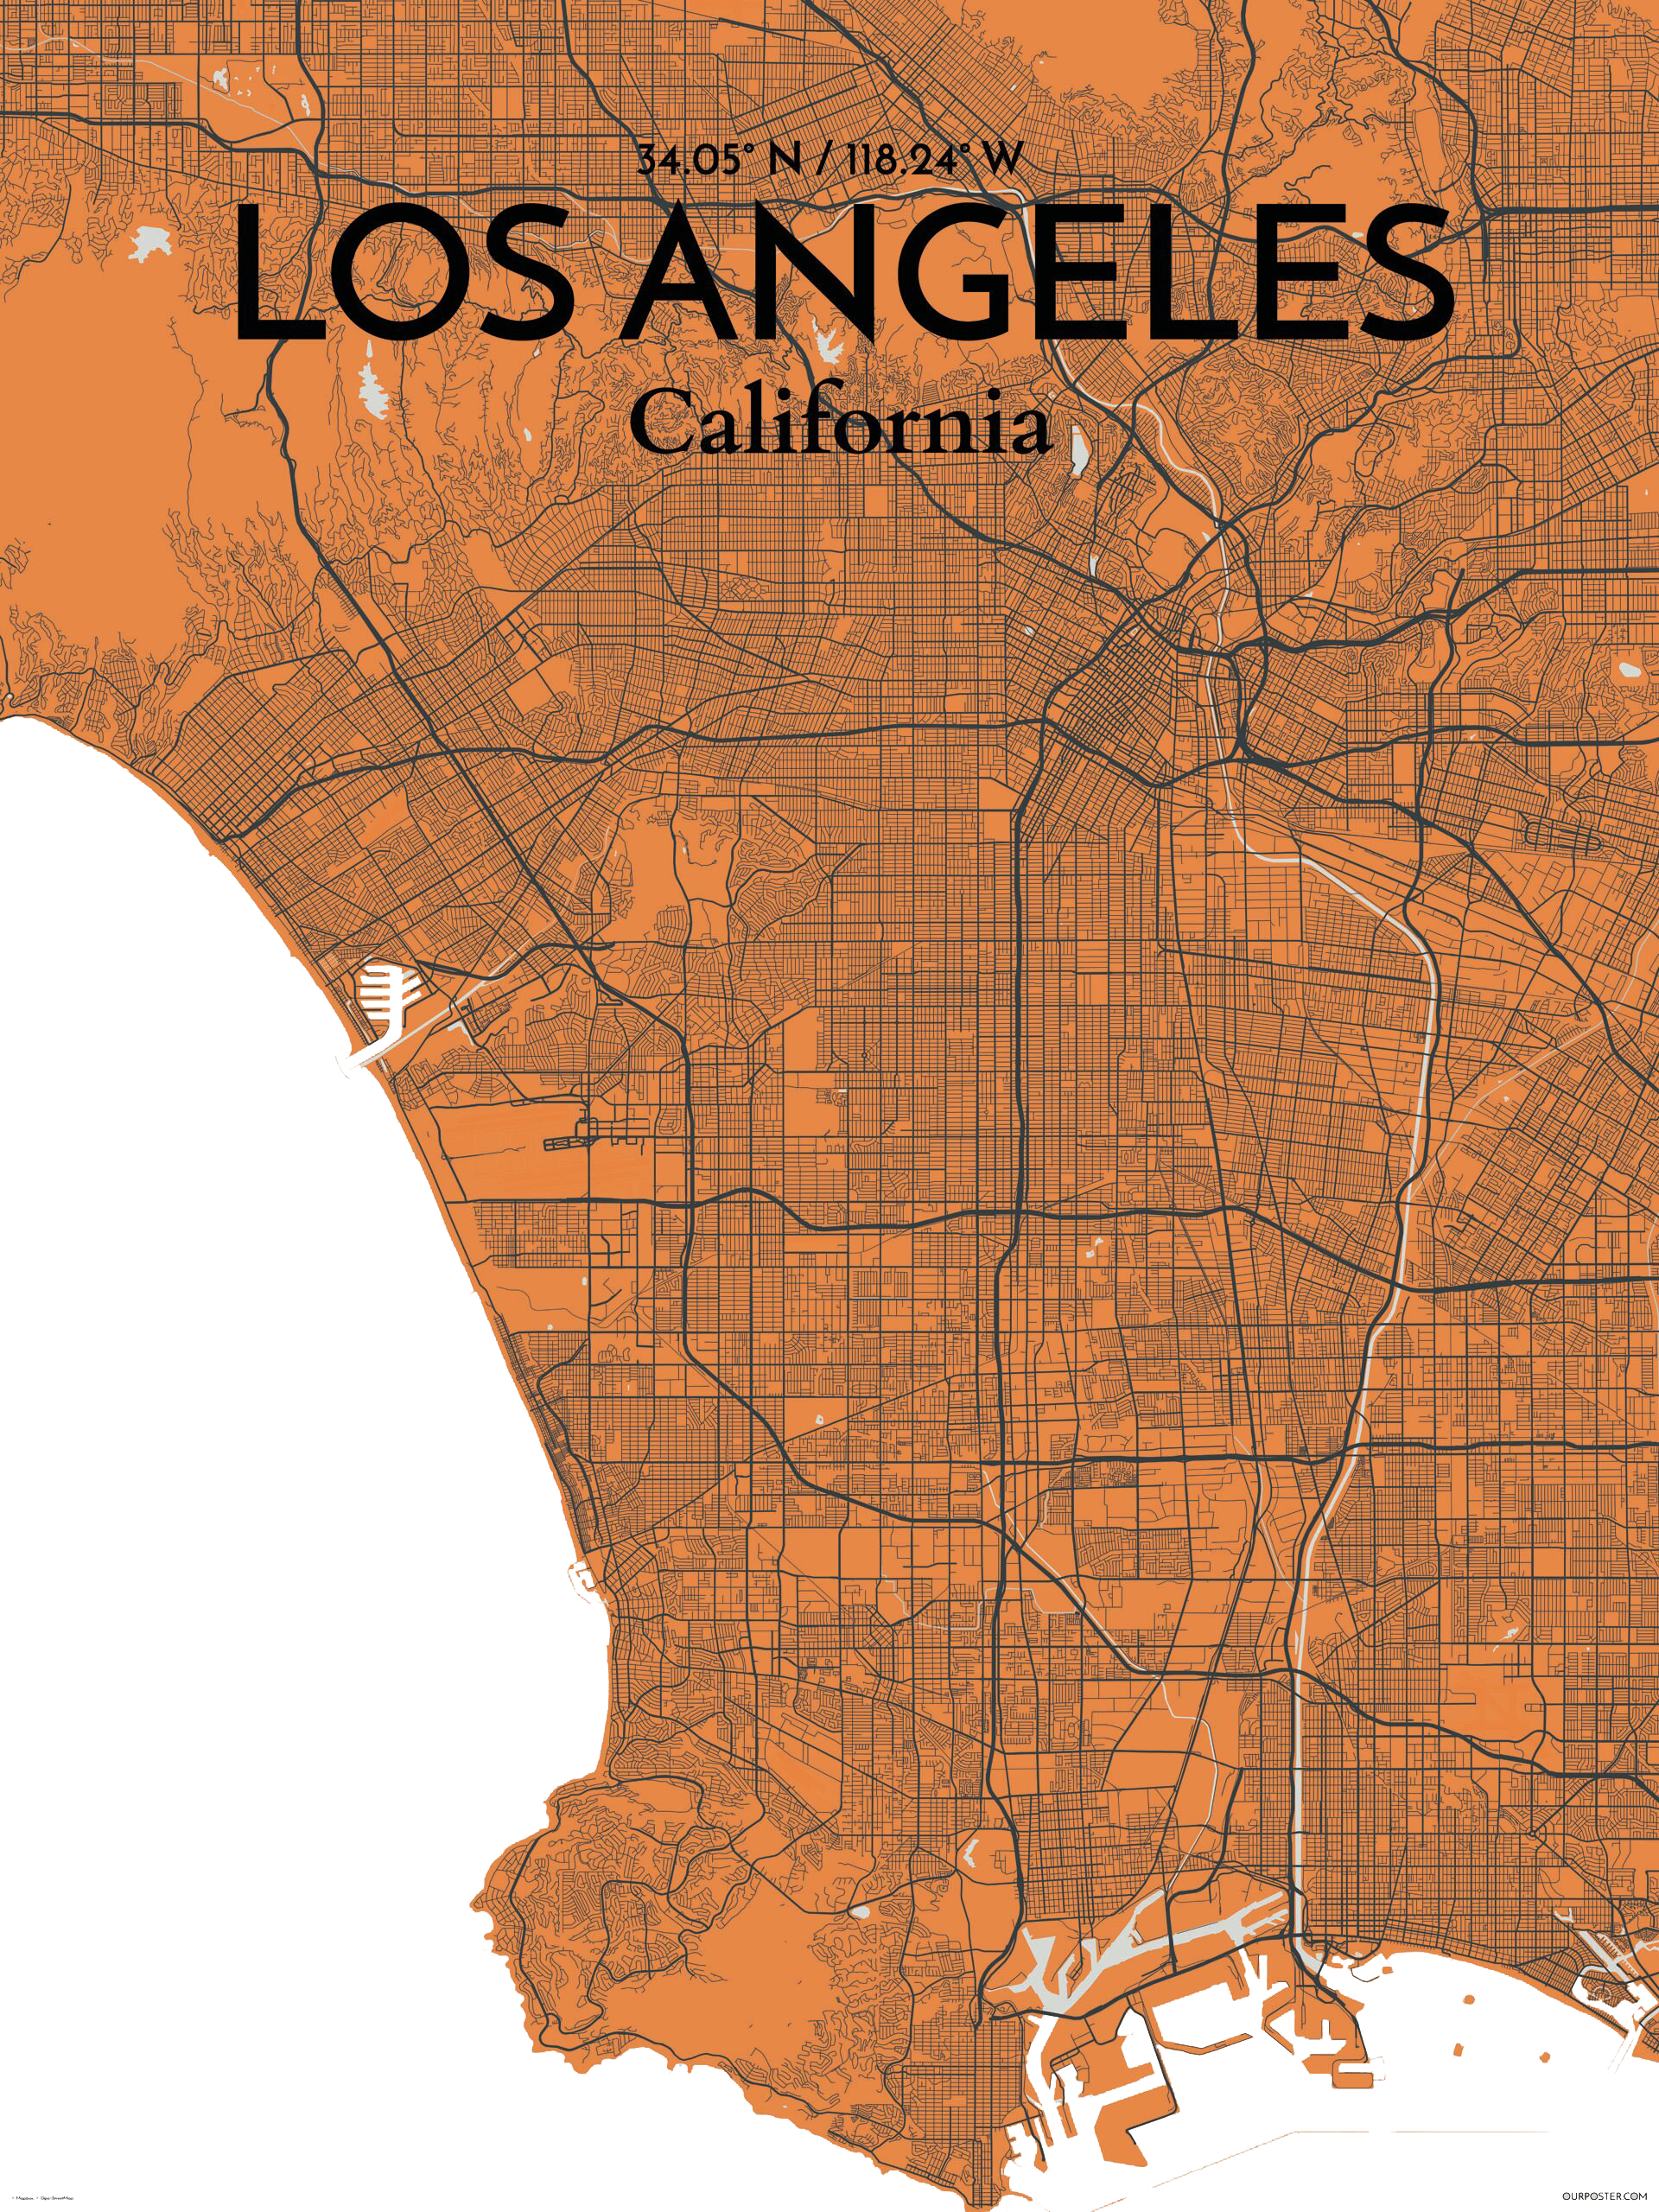

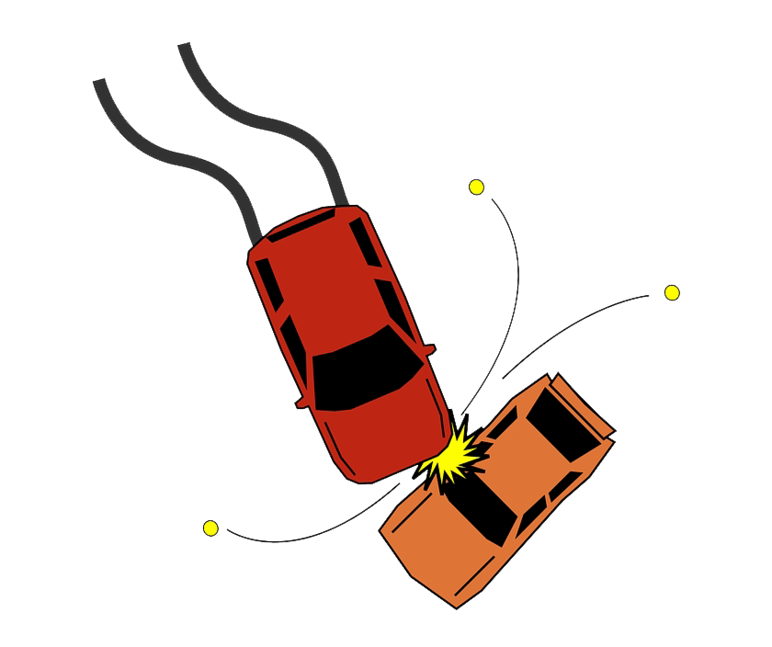

Car Accidents Sprint Review
|
George Tseperkas
Notes:
Καλησπέρα, ονομάζομαι Σαρρής Αντώνιος και στο πλαίσιο της εργασίας αντικείμενο της έρευνας μου ήταν το φυσικό καινοτόμο κατάστημα Amazon GO

Slide 2

Datathlon Project
Datathlon Project: Car Accidents
Welcome to my Datathlon project, "Car Accidents"! This project was completed as part of the Professional Diploma in Data Analytics program offered by Deree the American College of Greece and Big Blue Data Academy.
The Datathlon concept is a training program designed to simulate real-world data analytics scenarios. For this project, we were provided with a car accident dataset for Los Angeles, and our task was to analyze it and provide insights using different tools such as Python and Power BI.
Our approach was to act as a small research team, working to identify potential solutions to a real-life problem faced by the state of California and the city of Los Angeles.
Data Overview
The car accident dataset used in this project was provided by the program. It contained information on car accidents in Los Angeles from 2016 to 2021. We began our analysis by cleaning and pre-processing the data to remove duplicates, handle missing values, and ensure consistency in the data. This allowed us to perform more accurate analysis and provide insights that could be used to improve road safety in the city.
Analysis Overview
In our analysis, we used a variety of data visualization tools, including Python and Power BI, to identify trends and patterns in a car accident dataset. Our focus was on identifying the relationships between the time of day, weather conditions, and severity of accidents. We created several charts using Python, such as a count plot showing the relationship between severity and daylight/night, a line plot illustrating the number of accidents per hour and month, and a clustered bar chart displaying the relationship between weather conditions and severity.
Car Accidents | S0

Slide 3

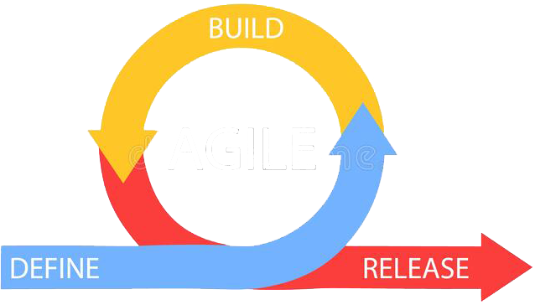
Target
Car Accidents
EPIC
Sprint 0
Sprint 1
Car Accidents | S0

Slide 4





Overview
Seasonality
Analysis
Cleaning
Visualization
Sprint 1
Car Accidents | S0

Slide 5
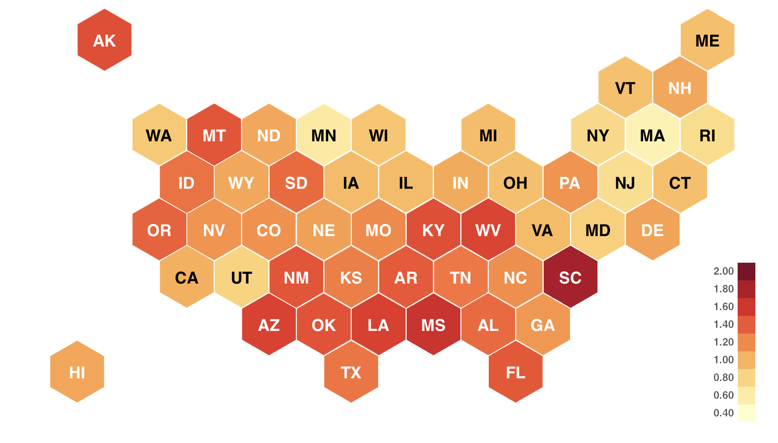
Research
Car Accidents | S0

Slide 6

Data Structure
68956
ID | Number | Weather_Timestamp | Amenity | Traffic_Calming
Severity | Street | Temperature(F) | Bump | Traffic_Signal
Start_Time | Side | Wind_Chill(F) | Crossing | Turning_Loop
End_Time | City | Humidity(%) | Give_Way | Sunrise_Sunset
Start_Lat | County | Pressure(in) | Junction | Civil_Twilight
Start_Lng | State | Visibility(mi) | No_Exit | Nautical_Twilight
End_Lat | Zipcode | Wind_Direction | Railway | Astronomical_Twilight
End_Lng | Country | Wind_Speed(mph) | Roundabout
Distance(mi) | Timezone | Precipitation(in) | Station
Description | Airport_Code | Weather_Condition | Stop
2016-2022
Car Accidents | S0

Slide 7
Data Cleaning
63161
ID | Number | Weather_Timestamp | Amenity | Traffic_Calming
Severity | Street | Temperature(F) | Bump | Traffic_Signal
Start_Time | Side | Wind_Chill(F) | Crossing | Turning_Loop
End_Time | City | Humidity(%) | Give_Way | Sunrise_Sunset
Start_Lat | County | Pressure(in) | Junction | Civil_Twilight
Start_Lng | State | Visibility(mi) | No_Exit | Nautical_Twilight
End_Lat | Zipcode | Wind_Direction | Railway | Astronomical_Twilight
End_Lng | Country | Wind_Speed(mph) | Roundabout
Distance(mi) | Timezone | Precipitation(in) | Station
Description | Airport_Code | Weather_Condition | Stop
Car Accidents | S0

Slide 8
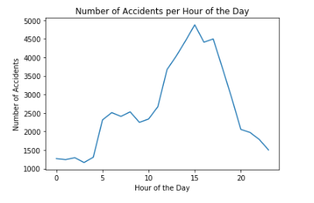
Seasonality
Car Accidents | S0

Slide 9
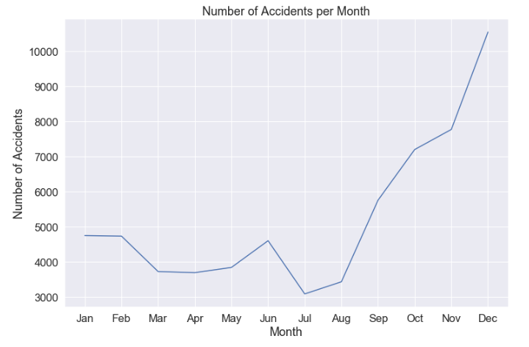
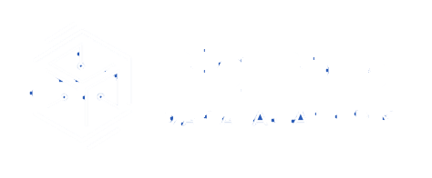
Seasonality
Car Accidents | S0

Slide 10
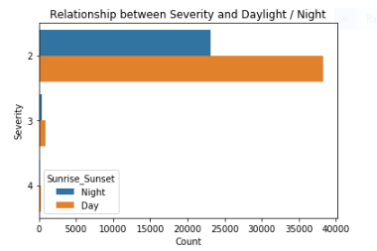
Most Severe Accidents happen Daylight | Night | Weekend
Car Accidents | LA

Slide 11
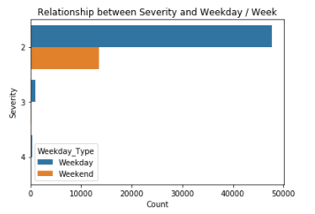
Most Severe Accidents happen Daylight | Night | Weekend
Car Accidents | S0

Slide 12
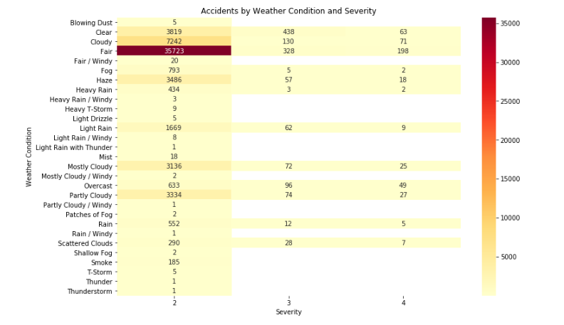
Accidents | Weather | Severity
Car Accidents | S0

Slide 13
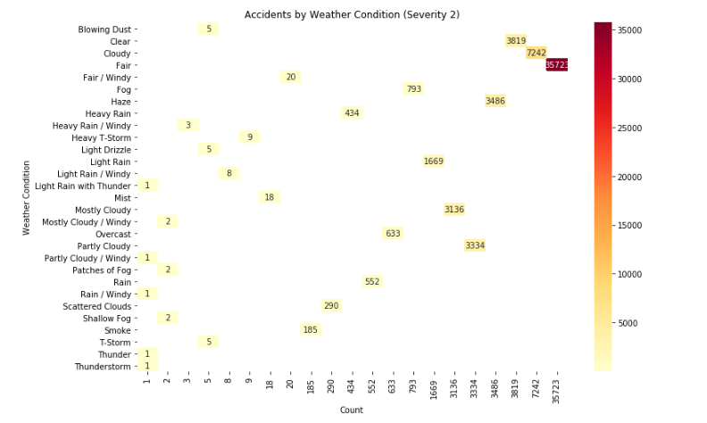
Accidents | Weather by Severity
Car Accidents | S0

Slide 14
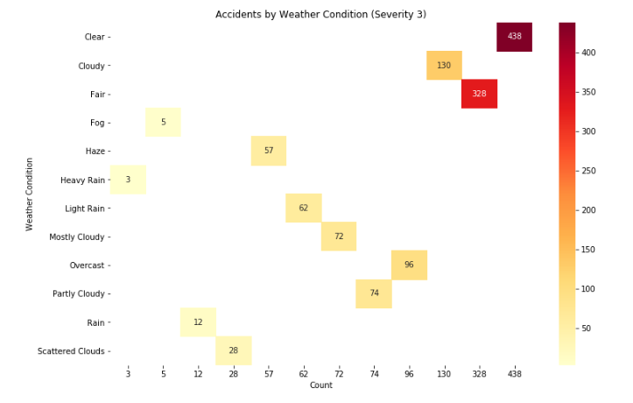
Accidents | Weather by Severity
Car Accidents | S0

Slide 15
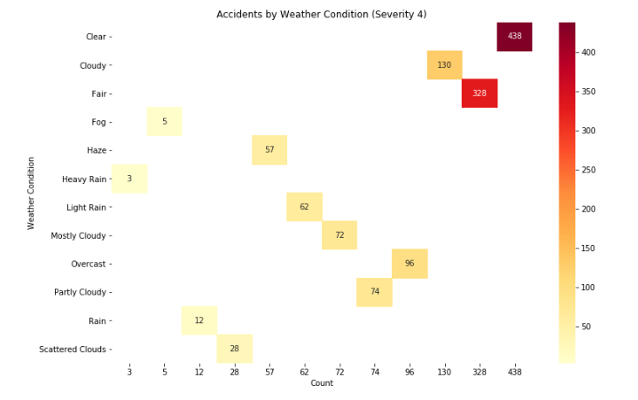
Accidents | Weather by Severity
Car Accidents | S0

Slide 16
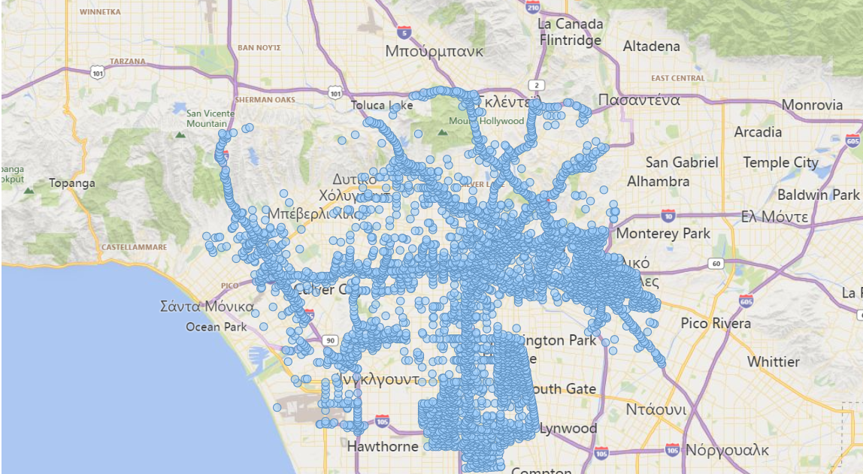
Severity Visualization | 2
Car Accidents | S0

Slide 17
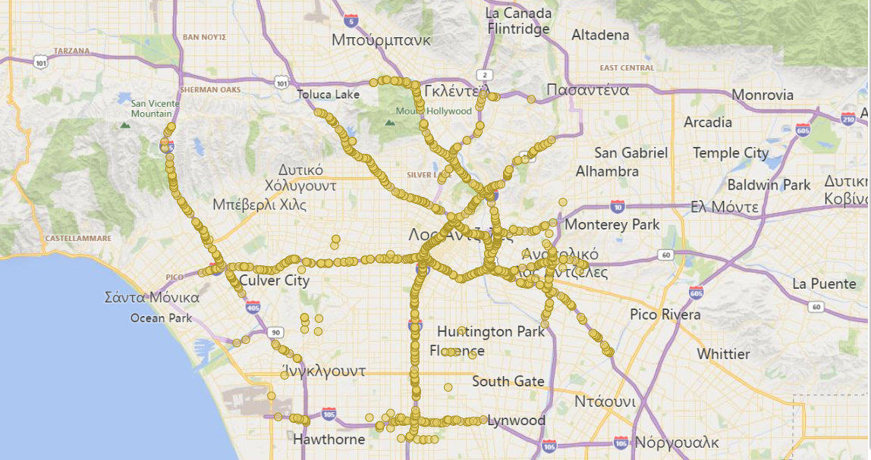
Severity Visualization | 3
Car Accidents | S0

Slide 18
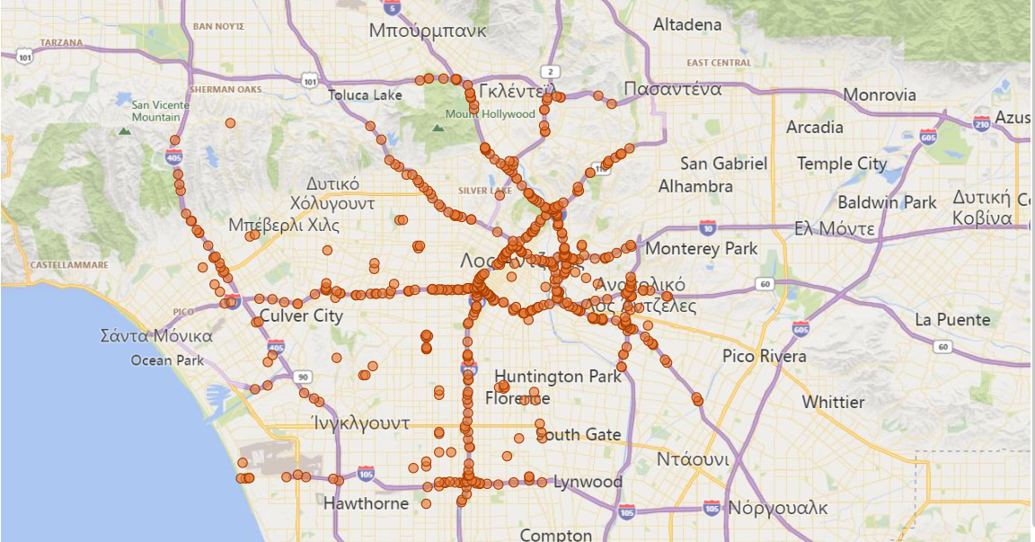
Severity Visualization | 4
Car Accidents | S0

Slide 19
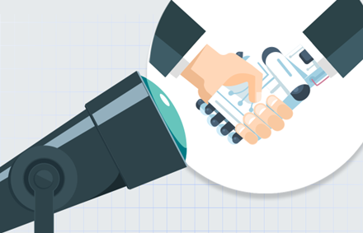
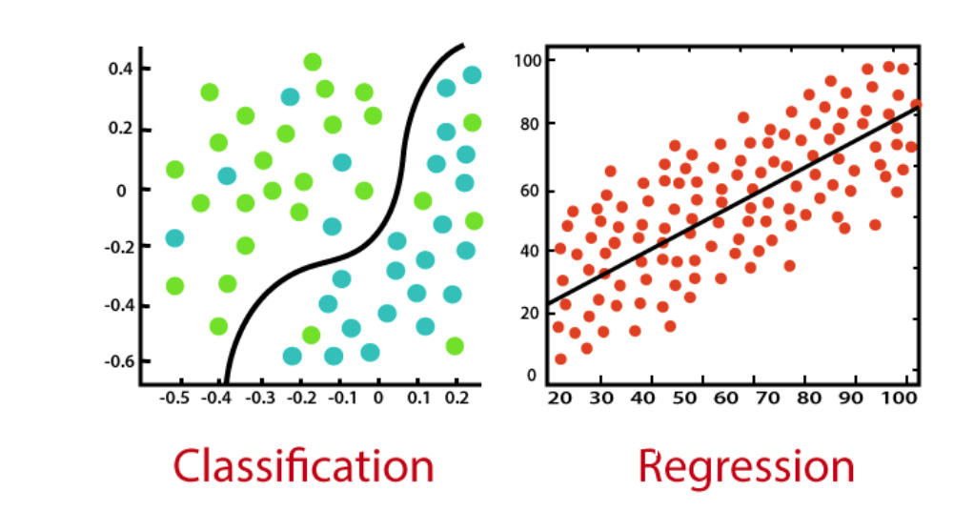
Sprint 1
Car Accidents | S0

Slide 20
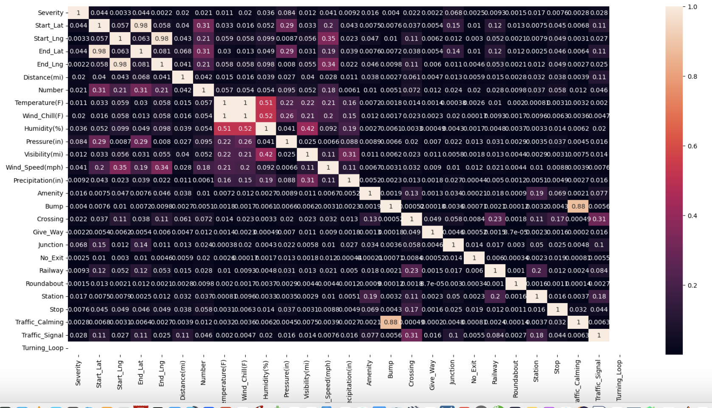
Correlation
Car Accidents | S0

Slide 21


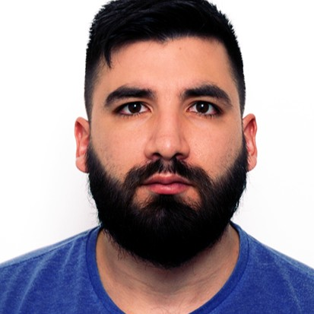


George Tseperkas

